Slide 1




DATA STRUCTURES IN PYTHON
PRESENTATION BY
LEVIATHAN 7

Slide 2








AGENDA
LIST
Sanjay
TUPLE
Vamshi
SETS
Parves
DICTIONARIES
Monesh
METHODS & OPERATIONS
Teja
NESTED STRUCTURES
Malar
ITERATION & MANIPULATION
Asmitha

Slide 3




















LISTS IN PYTHON
List Memory Layout
ORDERED
Elements maintain their insertion order and can be accessed by zero-based index.
MUTABLE
INDEX
A list can be changed after creation: elements can be added, removed, or replaced.
VALUE
DUPLICATES ALLOWED
Repeated values are allowed and stored as distinct indexed items.
Access by Index: numbers[2]
30
HETEROGENEOUS
A single list can store different data types (strings, integers, floats, booleans).
HOW A LIST IS CREATED
1. BASIC SYNTAX
2. EMPTY LIST
3. LIST() CONSTRUCTOR
list((1, 2, 3))

Slide 4
















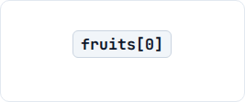
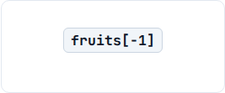


INDEXING & SLICING
01 INDEXING
02 SLICING
numbers[1:4]
+ INDEX
VALUE
- INDEX
[START : STOP : STEP]
START: 1 (incl.)
STOP: 4 (excl.)
STEP: 1
FIRST ELEMENT
LAST ELEMENT
REVERSAL SLICING
numbers[::-1]
Positive starts at 0 (left-to-right); Negative starts at -1 (right-to-left).
Slicing always creates a new list containing the selected elements.

Slide 5













LISTS CAN CHANGE
BEFORE numbers = [10, 20, 30]
REASSIGN INDEX 1 numbers[1] = 200
AFTER [10, 200, 30]
append(x)
insert(i, x)
extend(iter)
Adds a single element to the end of the list.
Inserts element at the specified index position.
Appends all elements from an iterable to the end.
remove(x)
pop([i])
clear()
Removes first matching occurrence of value.
Removes and returns item at index (default: last).
Empties the entire list of all its elements.

Slide 6












WORKING WITH LISTS
01 CONCATENATION
02 REPETITION
Merges two distinct lists into a brand new combined sequence.
Duplicates the elements of a list a specified integer number of times.
03 MEMBERSHIP
04 ITERATION
Tests whether a value exists within the list, returning a boolean result.
for
in
10
20
30
→ →
2 in [1, 2, 3]
5 not in [1, 2, 3]
print
Length
Minimum
Maximum
Sum total

Slide 7




















TUPLES IN PYTHON
Tuple Memory Structure t = ("A", "B", "C", "D")
ORDERED
Elements maintain their order and can be accessed by index.
INDEX
IMMUTABLE
Tuple elements cannot be added, removed, or reassigned.
VALUE
DUPLICATES ALLOWED
Repeated values are permitted and stored distinctly.
Positional Access: t[2]
"C"
HETEROGENEOUS
A tuple can store different data types together.
How a Tuple is Created
1. BASIC SYNTAX
2. SINGLE ITEM TRAILING COMMA
3. TUPLE() CONSTRUCTOR
(5,) ✓ Tuple (5) ✕ Int
tuple([1, 2, 3])

Slide 8

























ACCESSING & WORKING WITH TUPLES
01. INDEXING
t = ("A", "B", "C", "D")
02. SLICING
t = (10, 20, 30, 40, 50)
+ POS
t[1:4]
VALUE
- NEG
t[0]
t[-1]
t[::-1] → Returns new tuple
03. OPERATORS & METHODS
04 ITERATION for-loop traversal
Concatenation (+)
for
in
"A"
"B"
"C"
print
→ →
Repetition (*)
Membership (in)
Built-ins: len(), min(), max(), sum()
TUPLE CAPABILITIES SUMMARY

Slide 9












IMMUTABILITY, PATTERNS & COMPARISON
Reassignment Attempt
Immutability Nuance
10
20
30
TypeError:
1
2
3
0
append
1
200
# Error!
4
# ([1, 2, 4], 3)
del t[0] del t
Reference is fixed, but nested mutable objects inside can still be changed.
01 PACKING & UNPACKING
02 SWAPPING
03 NESTED TUPLES
# Packing
"A"
90
"B"
10
85
"Vamshi"
22
20
"AI"
0
# Unpacking
# Tuple Swap
1
Variables match positionally.
a → 20 b → 10
[0]=Inner, [1]=Score
List vs. Tuple Comparison
FEATURE | LIST [ ] | TUPLE ( ) | DICTIONARY KEY HASHABILITY
Mutability | Mutable | Immutable | List: Never allowed as Key
Add / Remove / Reassign | Supported | Not Supported | Tuple: Allowed ONLY if all elements are hashable

Slide 10













SETS IN PYTHON
Automatic Deduplication numbers = {1, 2, 3, 3, 4}
UNIQUE
Duplicate elements are automatically eliminated upon insertion.
INPUT RAW DATA (CONTAINS DUPLICATE)
UNORDERED
Elements have no fixed position, index, or slice support.
RESULTING SET OBJECT
MUTABLE
Elements can be added or removed after the set is created.
Unordered: No Positional Indexing
TypeError
HASHABLE ELEMENTS
Elements must be immutable (numbers, strings, tuples).
How a Set is Created
✓ Set
1. BASIC SYNTAX
2. EMPTY SET SYNTAX
3. SET() CONSTRUCTOR
set() ✓ Set {} ✕ Dict
set([1, 2, 2, 3])

Slide 11














CREATING & MODIFYING SETS
add(x) — Single Element
update(iterable) — Multiple
"apple"
"apple"
"banana"
"grape"
update
add
"mango"
"kiwi"
remove(x)
discard(x)
pop()
clear()
1
2
3
1
2
3
10
20
30
1
2
3
remove
2
discard
99
pop
clear
Raises KeyError if absent
Safe: No error if missing
Removes arbitrary item
Result → set()
O(1) Fast Membership Testing
USEFUL BUILT-IN FUNCTIONS
20 in {10, 20, 30} 50 not in {10, 20}
len(s) min(s) max(s) sum(s)
SET CAPABILITIES SUMMARY

Slide 12













SET OPERATIONS & COMPARISON
01 UNION (|) A.union(B)
02 INTERSECTION (&) A.intersection(B)
03 DIFFERENCE (-) A.difference(B)
04 SYM. DIFF (^) A.sym_diff(B)
{1, 2, 3}
{2}
{1}
{1, 3}
All elements from both sets.
Common elements only.
Elements in A but not B.
Elements in either, not both.
Relationship Checks
Set Comprehension
frozenset
issubset
True
for
in
An immutable set object. Hashable and valid as a dictionary key or set element.
isdisjoint
True
# Output: {1, 4, 9} (Deduplicated)
List vs. Set Decision Framework
FEATURE | LIST [ ] | SET { } | PRIMARY USE CASE
Ordering & Indexing | Ordered (Indexable) | Unordered (No Index) | List: Positional access & sequence order matter
Duplicates & Lookup | Duplicates Allowed | Unique Only (O(1) Search) | Set: Removing duplicates & fast membership testing

Slide 13





DICTIONARIES IN PYTHON
Key–Value Mapping Structure
KEY → VALUE
Data is stored in associated pairs linking a unique key to a value.
Key (Unique & Hashable) | Mapping | Value (Any Data Type)
"name" |  | "Rahul"
"age" |  | 22
"branch" |  | "AI"
UNIQUE KEYS
Keys must be unique; re-assigning an existing key updates its value.
MUTABLE
Pairs can be added, updated, or deleted after dictionary creation.
MEANINGFUL ACCESS
Access Value by Key: student["name"]
Values are retrieved instantly via named keys rather than numeric indices.
How a Dictionary is Created
1. LITERAL SYNTAX
2. EMPTY DICTIONARY
3. DICT() CONSTRUCTOR
d = {} dict object
dict(name="Rahul", age=22)

Slide 14








WORKING WITH DICTIONARIES
01 ACCESSING & SAFE LOOKUP d = {"name": "Rahul", "age": 22}
02 ADDING & UPDATING
NEW KEY INSERTION
Bracket Access: d["name"]
d["city"] = "Hyderabad"
Missing Key Bracket:
EXISTING KEY REASSIGNMENT
Safe get() Method:
d["age"] = 23
03 REMOVING DATA
04 MEMBERSHIP & ITERATION "name" in d → True
del d[k]
pop(k)
Deletes key-value pair
Removes & returns val
for
in
items
Iteration Rules:
popitem()
clear()
print
"->"
Keys
(Key, Val)
Removes LAST inserted
Empties dict → {}
DICTIONARY CAPABILITIES SUMMARY

Slide 15









DICTIONARY METHODS & APPLICATIONS
01 keys() View d.keys()
02 values() View d.values()
03 items() & update() d.update(d2)
keys
values
update
23
"Hyd"
dict_keys(['a', 'b'])
dict_values([1, 2])
Bulk inserts or updates pairs
Dynamic view of all keys in dict.
Dynamic view of all values in dict.
Merges another dictionary in-place.
Nested Dictionaries
Dictionary Comprehension
"s1"
"name"
"Rahul"
"score"
90
for
in
1
2
3
"s1"
"score"
# Output: {1: 1, 2: 4, 3: 9}
List vs. Dictionary Selection Framework
FEATURE | LIST [ ] | DICTIONARY { } | PRIMARY USE CASE
Access Method | Numeric Index lst[0] | Unique Key dict["key"] | List: Sequential positional access
Duplicates & Order | Duplicate values allowed | Unique Keys (Values may duplicate) | Dict: Labeled entity properties & fast lookups

Slide 16


A
1
2
2
3
4
B
3
4
5
print
A
B
What will be the output?

Slide 17








A
1
2
2
3
4
B
3
4
5
print
A
B
What will be the output?
{1, 2, 2}
{1, 2}
{2, 3, 4}
{1, 2, 3, 4, 5}

Slide 18







A
1
2
2
3
4
B
3
4
5
print
A
B
What will be the output?
{1, 2, 2}
{1, 2}
{2, 3, 4}
{1, 2, 3, 4, 5}
Correct answer: B. {1, 2}
Duplicate elements are automatically removed from a set, so A becomes {1, 2, 3, 4}. Subtracting B removes 3 and 4, leaving {1, 2}.

Slide 19

t
10
20
30
40
t
1
append
50
print
t
What will be the output?

Slide 20

t
10
20
30
40
t
1
append
50
print
t
What will be the output?
(10, [20, 30], 40)
(10, [20, 30, 50], 40)
Error — Tuple cannot be modified
(10, 20, 30, 50, 40)

Slide 21
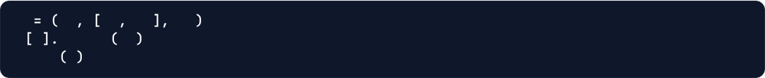
t
10
20
30
40
t
1
append
50
print
t
What will be the output?
(10, [20, 30], 40)
(10, [20, 30, 50], 40)
Error — Tuple cannot be modified
(10, 20, 30, 50, 40)
Correct answer: B. (10, [20, 30, 50], 40)
The tuple itself is immutable, but the list inside it is mutable. append(50) changes the inner list.

Slide 22

d
"a"
10
"b"
20
"a"
30
print
d
What will be the output?

Slide 23





d
"a"
10
"b"
20
"a"
30
print
d
What will be the output?
{"a": 10, "b": 20, "a": 30}
{"a": 30, "b": 20}
{"a": 10, "b": 20}
Error — Duplicate keys are not allowed

Slide 24
d
"a"
10
"b"
20
"a"
30
print
d
What will be the output?
{"a": 10, "b": 20, "a": 30}
{"a": 30, "b": 20}
{"a": 10, "b": 20}
Error — Duplicate keys are not allowed
Correct answer: B. {"a": 30, "b": 20}
Dictionary keys must be unique. The second "a": 30 replaces the earlier value 10.

Slide 25

a
10
20
30
b
a
b
1
99
print
a
print
b
What will be the output?

Slide 26





a
10
20
30
b
a
b
1
99
print
a
print
b
What will be the output?
[10, 20, 30] [10, 99, 30]
[10, 99, 30] [10, 20, 30]
[10, 99, 30] [10, 99, 30]
Error — b is a copy of a

Slide 27
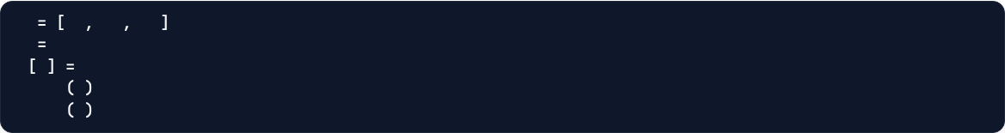

a
10
20
30
b
a
b
1
99
print
a
print
b
What will be the output?
[10, 20, 30] [10, 99, 30]
[10, 99, 30] [10, 20, 30]
[10, 99, 30] [10, 99, 30]
Error — b is a copy of a
Correct answer: C. [10, 99, 30] / [10, 99, 30]
b = a makes both variables refer to the same list. Changing the list through b also changes what a refers to.

Slide 28





PYTHON DATA STRUCTURE OPERATIONS
OPERATION | LIST [ ] | TUPLE ( ) | SET { } | DICTIONARY { }
01 Access / Indexing | ✓ lst[0] | ✓ t[0] | ✕ No Index | ✓ d[key] (Key-based)
02 Slicing [start:stop] | ✓ lst[1:4] | ✓ t[1:4] | ✕ Unsupported | ✕ Unsupported
03 Concatenation (+) | ✓ [1] + [2] | ✓ (1,) + (2,) | ✕ Use union() | ✕ Use update()
04 Repetition (*) | ✓ [1, 2] * 2 | ✓ (1, 2) * 2 | ✕ Unsupported | ✕ Unsupported
05 Membership (in) | ✓ x in lst | ✓ x in t | ✓ x in s (O(1)) | ✓ key in d (Checks Keys)
06 Iteration (for x in) | ✓ Sequence | ✓ Sequence | ✓ Unique Items | ✓ Keys / .items()
07 Length len() | ✓ Item count | ✓ Item count | ✓ Unique count | ✓ Pair count
SEQUENCE OPS
COMMON OPS
SET-SPECIFIC
DICT-SPECIFIC
Positional indexing, slicing, concatenation (+), and repetition (*). Supported by Lists & Tuples.
Membership (in), loop iteration, and length (len()) work on ALL four structures.
Mathematical set algebra: Union (|), Intersection (&), Difference (-), and Sym. Diff (^).
Key-based retrieval (d[k]), safe lookups (get()), and pair iteration (.items()).

Slide 29













DATA STRUCTURE METHODS
LIST
TUPLE
SET
DICTIONARY
append(x)
add(x) / update()
get(k, [def])
Adds single item x to end
Add single element vs bulk iterable
Safe lookup (returns None/default)
extend(iter)
remove(x)
keys() / values()
Appends all elements from iterable
Strict deletion (raises KeyError)
Returns dynamic view of keys/values
insert(i, x)
ONLY 2 METHODS
discard(x)
items()
Inserts x at specified index i
Tuples cannot be mutated; only read-only search methods exist.
Safe deletion (no error if missing)
Dynamic view of (key, value) pairs
remove(x)
pop()
update(dict2)
Removes first matching value x
count(x)
Removes & returns arbitrary item
Bulk adds or updates key-value pairs
pop([i])
Returns total occurrences of value x
union() / intersection()
pop(k)
Removes & returns item at index
index(x)
Set algebra methods (or |, &)
Removes key & returns value
sort() / reverse()
Returns first index position of value x
difference() / sym_diff()
popitem()
In-place sorting & reversal
NOTE ON BUILT-INS
Relative & symmetric difference
Removes & returns last inserted pair
index() / count()
len(), min(), max(), sum() are Python built-in functions, NOT Tuple methods.
issubset() / isdisjoint()
setdefault(k, d)
Positional lookup & frequency count
Boolean relationship checks
Gets value or inserts default key
METHOD ROLES SUMMARY:
List: In-place Sequence Editing Tuple: Read-Only Lookup Set: Uniqueness & Set Algebra Dict: Key-Value Mapping

Slide 30




LIST vs TUPLE vs SET vs DICTIONARY
FEATURE | LIST [ ] | TUPLE ( ) | SET { } | DICTIONARY { }
Syntax Example | [10, 20, 30] | (10, 20, 30) | {10, 20, 30} | {"a": 10, "b": 20}
Ordering | Ordered Sequence | Ordered Sequence | No Positional Order | Preserves Insertion Order
Mutability | ✓ Mutable | ✕ Immutable | ✓ Mutable | ✓ Mutable
Duplicates | ✓ Allowed | ✓ Allowed | ✕ Unique Only | Keys: ✕ Unique | Values: ✓
Access Method | Numeric Index lst[0] | Numeric Index t[0] | ✕ No Positional Access | Unique Key d["key"]
Element Rule | Any Python object | Any Python object | Must be Hashable | Keys Hashable / Values Any
SYMBOL REFERENCE:
[] Index
[::] Slice
+ Concat
* Repeat
in Search
| Union
& Intersect
- Diff
^ Sym Diff
USE A LIST
USE A TUPLE
USE A SET
USE A DICTIONARY
When you need an ordered collection that changes frequently and relies on positional indexing or duplicates.
When data should remain fixed and read-only, or serve as a hashable key or record structure.
When you need automatic deduplication, fast $O(1)$ membership testing, or mathematical set operations.
When data represents labeled properties or key-value relationships requiring fast key lookup.

Slide 31
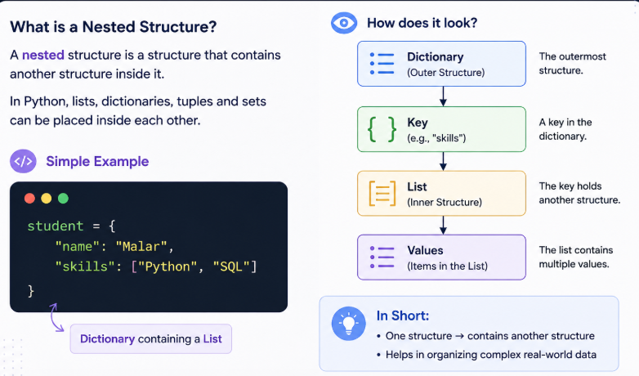
NESTED STRUCTURES

Slide 32
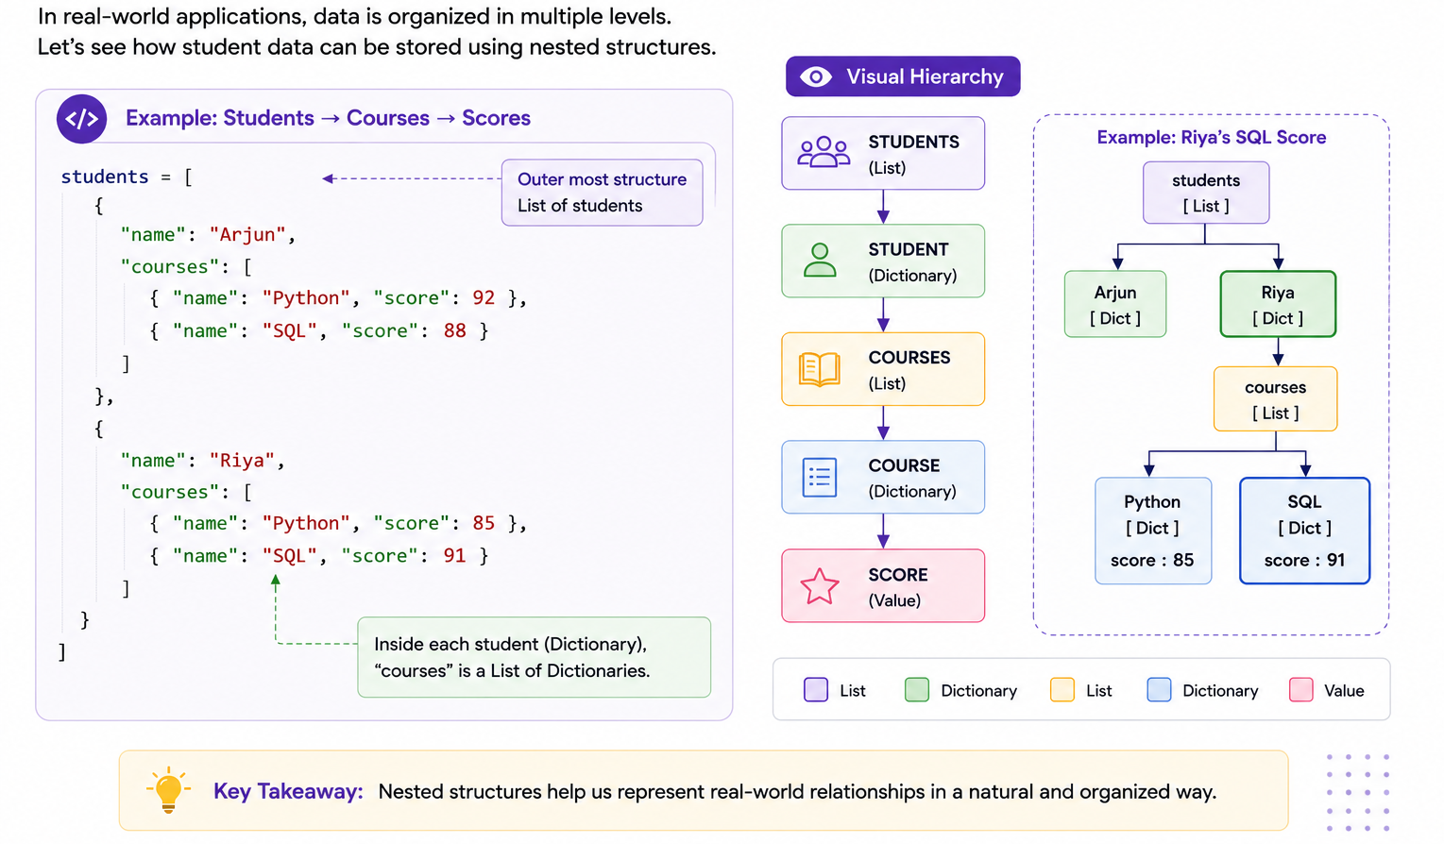

Slide 33
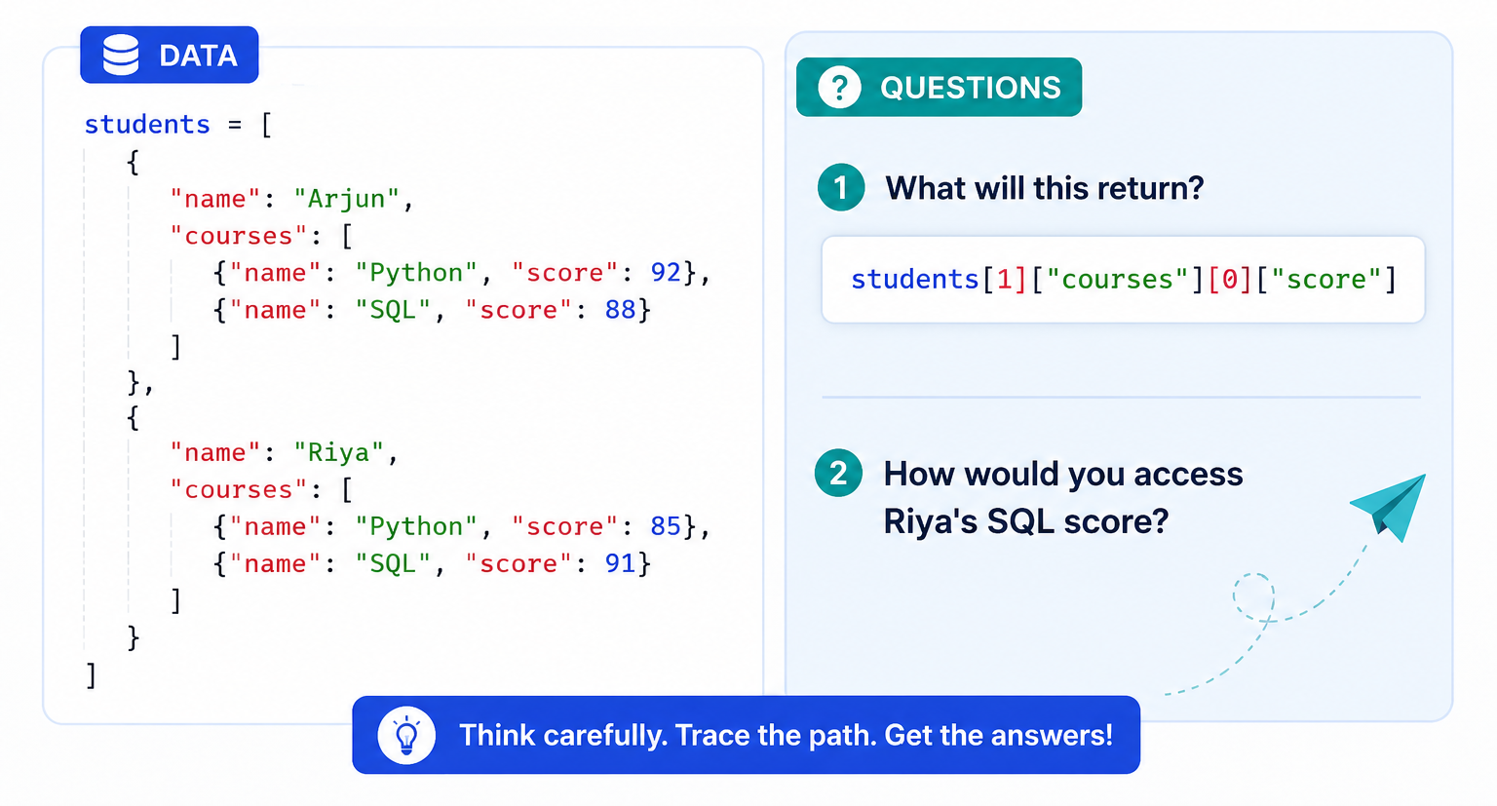
Can you trace the data?

Slide 34
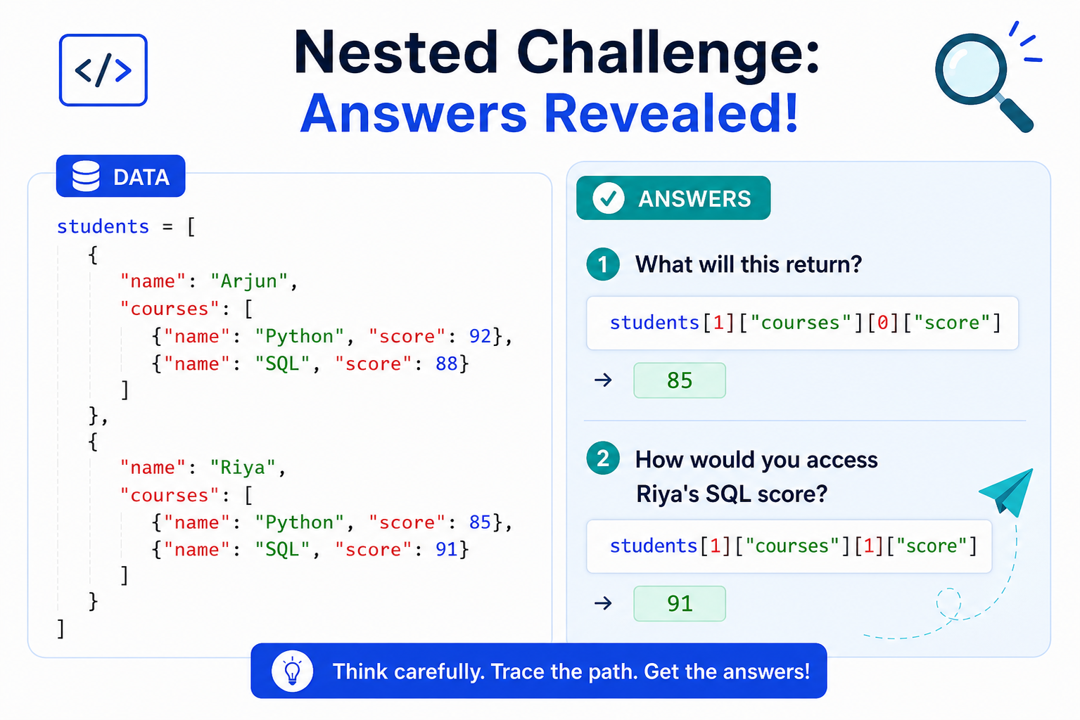
Can you trace the data?

Slide 35









ITERATION IN PYTHON
WHAT IS ITERATION?
FOR LOOP
for item in iterable:
WHILE LOOP
while condition:
Repeatedly executing a block of code for multiple items in a collection or until a boolean condition turns False.
Processes each element sequentially from an iterable object.
1
while
5
print
ITERATION EXECUTION FLOW
1
# Output: 1 2 3 4 5
SUPPORTED PYTHON ITERABLES
✓ List [1, 2] ✓ Tuple (1, 2)
✓ String "Py" ✓ Set {1, 2}
✓ Range range(5) ✓ Dict .items()
Infinite Loop Warning:
10
20
30
40
for
in
print
FOR: Known sequence
WHILE: Condition-based
ITERATION CORE FORMULA:

Slide 36


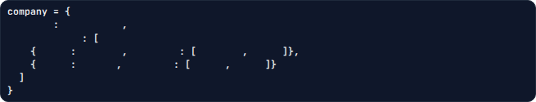
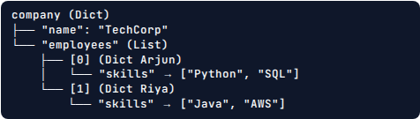



REAL-WORLD NESTED DATA & RECAP
Real-World API / JSON Record
Hierarchy Tree Diagram
"name"
"TechCorp"
"employees"
"name"
"Arjun"
"skills"
"Python"
"SQL"
"name"
"Riya"
"skills"
"Java"
"AWS"
MENTAL ACCESS PIPELINE
COMMON PITFALLS
• Using string key on a List → TypeError
• Using numeric index on a Dict → KeyError
• Confusing order: st[1]["courses"] vs st["courses"][1]
1. Start at outer structure → 2. Identify its container type → 3. Apply [index] for List or [key] for Dict → 4. Move 1 level deeper → 5. Repeat until value reached.
Classroom Challenge: Evaluate Expression students[1]["courses"][1]["score"]
Reasoning: students[1] (Riya) → ["courses"] (List) → [1] (SQL Dict) → ["score"]

Slide 37












LOOP CONTROL & DATA MANIPULATION
01. range(start, stop, step)
02. break vs continue
for
in
range
1
10
2
print
" "
# Output: 1 3 5 7 9
break (Exit Loop)
continue (Skip Step)
if
3
break
if
3
continue
Tip: range(5) yields 0, 1, 2, 3, 4
Generates numbers on demand
# Output: 1, 2
# Output: 1, 2, 4, 5
03. LIST MANIPULATION (MUTABLE)
04. STRING MANIPULATION (IMMUTABLE)
Adds to end
At index i
By value
By index
QUICK MANIPULATION SUMMARY:
ADD: append() / insert() REMOVE: remove() / pop() TRANSFORM: upper() / replace() SPLIT: split()

Slide 38






ITERATION + MANIPULATION
01 TRANSFORMING ELEMENTS
02 FILTERING DATA
1
2
3
4
5
for
in
1
2
3
4
5
6
for
in
range
len
2
# Output: [2, 4, 6, 8, 10]
if
2
0
append
# Output: [2, 4, 6]
DICTIONARY ITERATION .items()
NESTED TRAVERSAL
for
in
items
print
"->"
for
in
print
"name"
Traverses both keys and values simultaneously in a single loop.
Traverses outer collection and accesses inner structural keys level-by-level.
Complete Data Workflow & Common Pitfalls
1. COLLECTION
2. ITERATION
3. CONDITION
4. MANIPULATION
5. RESULT
❌ break exits loop (does not skip 1 item)
❌ continue skips 1 iteration (does not stop loop)
❌ remove() searches by value (not index)
✕ Strings return new objects (immutable)

Slide 39

x
1
2
3
y
x
for
i
in
y
x
remove
i
print
x
What will be the output?

Slide 40



x
1
2
3
y
x
for
in
i
y
x
remove
i
print
x
What will be the output?
[1, 2, 3]
[2, 3]
[2]
[3]

Slide 41

x
1
2
3
y
x
for
i
in
y
x
remove
i
print
x
What will be the output?
[1, 2, 3]
[2, 3]
[2]
[3]
Correct answer: C. [2]
The loop is iterating through the same list that is being modified. After removing 1, the list becomes [2, 3], but the loop moves to the next position, which is now 3. Removing 3 leaves [2].

Slide 42









CONCLUSION
Complete Course Journey: 01 to 07
LIST
TUPLE
SETS
DICTIONARIES
Ordered & mutable collections
Ordered & immutable collections
Unique elements & set operations
Key → value mappings
PROGRESSION STRATEGY
METHODS & OPS
NESTED STRUCTURES
ITERATION & MANIP.
Choose Structure → Apply Operation → Process Data
Work with & manipulate data
Build hierarchical data
Process & transform data
WHAT WE LEARNED
DATA PROCESSING PIPELINE
1. RAW DATA
Unstructured Input
Different structures solve different data-storage problems efficiently.
2. DATA STRUCTURE
List / Tuple / Set / Dict
Methods and operations allow precise access and manipulation of data.
3. OPERATIONS
Access & Modify
Nested structures enable complex multi-level records to be represented.
4. PROCESSING
Iteration & Logic
Iteration allows automated traversal and bulk transformation of collections.
Choosing the right structure makes programs clearer, faster, and easier to maintain.
5. USEFUL INFORMATION
Choose the right data structure, then use the right operation to process your data.

